Slide 1

DEVCON 2019
DEVCON 2019
Reaching for the stars
REST API TESTING TECHNIQUES FOR JAVA DEVS

Slide 2

Roger Janssen
Luminis
ABN AMRO CI [COE SD] JAVA SWAT
Foppinga Dreef / A4D
roger.janssen@nl.abnamro.com

Slide 3

GOAL:
Demonstrating how easy it can be to get your REST API covered. From writing your own integration tests to…
… automatic integration test generation.

Slide 4
Be able to run your integrations tests:
anywhere,
anytime,
without dependencies!

Slide 5


Slide 6

Jersey Test Framework

Slide 7
Jersey Test Framework
Developed by Jersey originally as internal test tool
support for multiple (embedded) containers
able to run against any external container

Slide 8

CODING EXAMPLE

Slide 9
Jersey Test
Pros
very fast execution times
simple to program
Cons
based on Junit4
you need to extend JerseyTest
no full CDI support (at least not without a fight)
not a production like application container

Slide 11

RestEasy

Slide 12
RestEasy
RestEasy is JBoss's implementation of the JAX-RS specification
Support for unit tests (to write integration tests)
In-memory / embedded http server support

Slide 13
CODING EXAMPLE

Slide 14
RestEasy
Pros
very fast execution times
simple to program
CDI support
reactive support
EJB, Seam, Guice, Spring, Spring MVC and Spring Boot integration
Cons
not a production like application container

Slide 16

Micro Profile - KumuluzEE
with RestAssured

Slide 17
MicroProfile
Java specification enabling lightweight Java builds and fast startup times (Microservice oriented)
KumuluZEE
Framework implementating the MicroProfile specification

Slide 18
CODING EXAMPLE

Slide 19
MicroProfile with KumuluzEE
Pros
Lightweight applications
Full JAX-RS and CDI support during tests
Cons
Arquillian quirks (Junit4 only!)
A tad more difficult to trace/debug
You may need to extend your API for testing

Slide 21

RestAssured and MockMVC
(with SpringBoot)

Slide 22
RestAssured (with SpringBoot)
HTTP abstraction layer
Full focus on validation / testing

Slide 23
CODING EXAMPLE

Slide 24
RestAssured
Pros
well established testing framework with a large community
in-built library of assertions, matchers and extractors
specifically designed and built for API automation testing
Cons
you need to add - too many? - dependencies to your pom
incompatibilities with the Spring BOM
requires your application to run (somewhere)

Slide 25
MockMVC
Pros
well established testing framework with a large community
in-built library of assertions, matchers and extractors
specifically designed and built for API automation testing
really easy to mock dependencies
Cons
lockin with Spring

Slide 27

Karate

Slide 28
Karate
Implements HTTP abstraction layer
Write Gherkin…
… and nothing else!

Slide 29
CODING EXAMPLE

Slide 30
Karate
Pros
BDD in one place (only Gherkin)
no back-end code required
readable integration tests
if you are lucky, no 'real' programming skills required
for complex stuff : javascript support
ability to call java classes (utility libs)
integration with Cucumber Reports

Slide 31
Karate
Cons
pretty quick developer skills become required!
managing initial test state can be complex
Cucumber Reports integration limited
it does not always work as expected (as example: tags, ignoring features, ...)

Slide 33

Spring Cloud Contract

Slide 34
Spring Cloud Contract
Part of umbrella Spring Cloud project
Focus on microservice testability
Automated generation of integration tests
Automated generation of stubs representing your (micro)service

Slide 35
CODING EXAMPLE

Slide 37
Spring Cloud Contract
Pros
your customers/clients can help define the behavior of your service
automatic generation of REST API tests
automatic stub generation (Wiremock)
no more refactoring required of your
integration tests when REST API changes
a stub runner for mocking dependencies
support for messaging APIs as well
powerful coding options in contract

Slide 38
Spring Cloud Contract
Cons
all mocking in one place
you may need multiple base test class implementations
only one test mode supported per project
compatibility issues with rest-assured
versioning issues with dependencies in the Spring BOM
a buy-in into Spring

Slide 40
Things to ponder?
Why am I using Spring Boot?
Is plain JAX-RS not more than enough my service?
Wat about Microprofile?

Slide 41
Questions?

Slide 42
Useful links:
https://p-bitbucket.nl.eu.abnamro.com:7999/projects/COESD/repos/devcon2019
https://p-bitbucket.nl.eu.abnamro.com:7999/projects/COESD/repos/test-examples-jee
https://p-bitbucket.nl.eu.abnamro.com:7999/projects/COESD/repos/test-examples-resteasy
https://p-bitbucket.nl.eu.abnamro.com:7999/projects/COESD/repos/test-examples-springboot
https://p-bitbucket.nl.eu.abnamro.com:7999/projects/COESD/repos/test-example-springboot-webflux
https://p-bitbucket.nl.eu.abnamro.com:7999/projects/COESD/repos/qcon-refactoring
https://p-bitbucket.nl.eu.abnamro.com:7999/projects/COESD/repos/qcon-solid

Slide 44
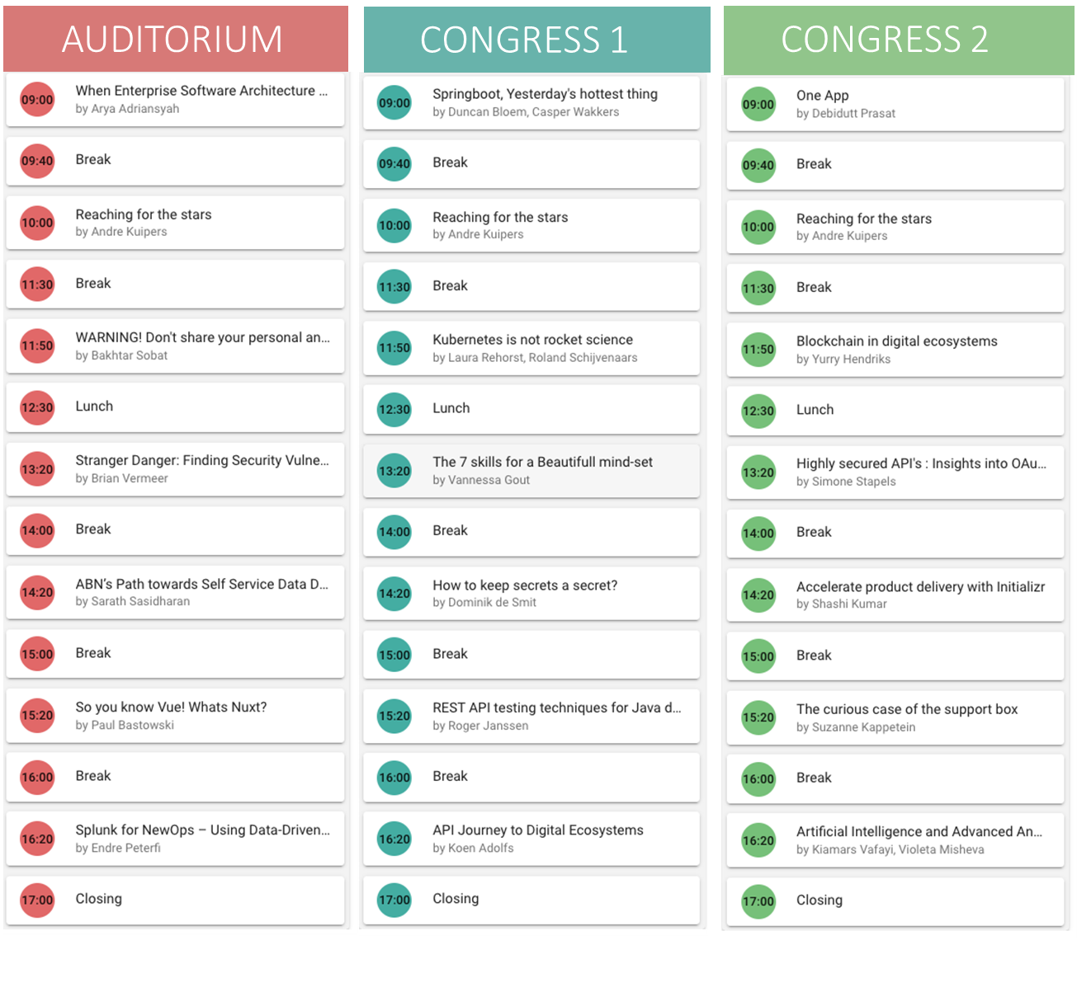
Monday 4th Nov
The DevCon programme for

